Slide 1
Integrating siloed student data into a unified relational database
DS5110 Final Project
John Chung, Daniela Alejandra Gonzalez, Noah Rae-Grant
Notes:
Proposed time and splits:
Intro - John (1 min)
Database Overview - John (1 min)
Challenge: primary key - John (1 min)
Challenge: confidentiality - Noah (2 min)
Creating School.db - Dani (1 min)
Example #1 - Dani (1.5 min)
Example #2 - Dani (1.5 min)
Conclusion - Noah (1 min)

Slide 2
Introduction

Slide 3

Real-World Problem
Academy X seeks to analyze student outcomes using data from Admissions and College Counseling Offices. However, the data is siloed in separate spreadsheets.
What challenges arise when integrating data from both offices?
How can a relational database deliver high-value insights through queries and visuals?
Notes:
Our final project addresses a real-world challenge: creating a relational database for an educational institution that currently lacks a DBMS (database management system). The project is grounded in the specific needs and requests of an actual independent high school, referred to as "Academy X" in this report. Academy X aims to better understand trends in student outcomes by leveraging data from its Admissions Office and College Counseling Office.
This presentation will focus on the following questions:
What does the process of integrating data from both offices look like in practice?
What are some examples of SQL queries and visualizations that might provide actionable insights?

Slide 4
Database overview

Slide 5
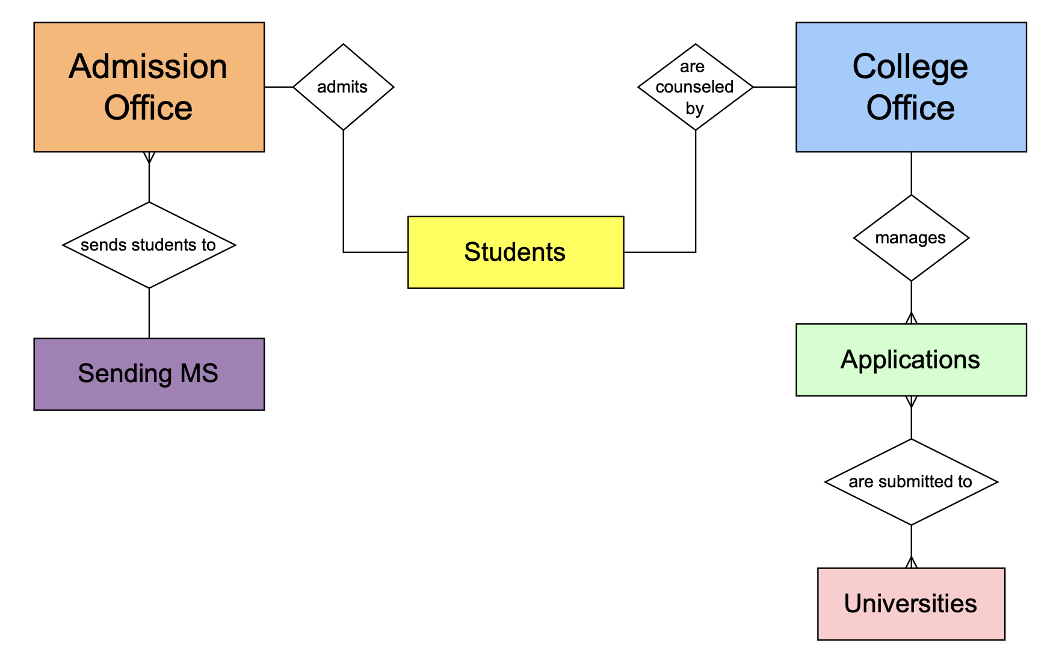
ERD (Relationships)
Notes:
Academy X’s admission office admits students from various Sending Middle Schools.
College Office counsels every student and sends students to various Universities.
Admissions Office holds all INCOMING student data while College Office holds all OUTGOING student data.

Slide 6
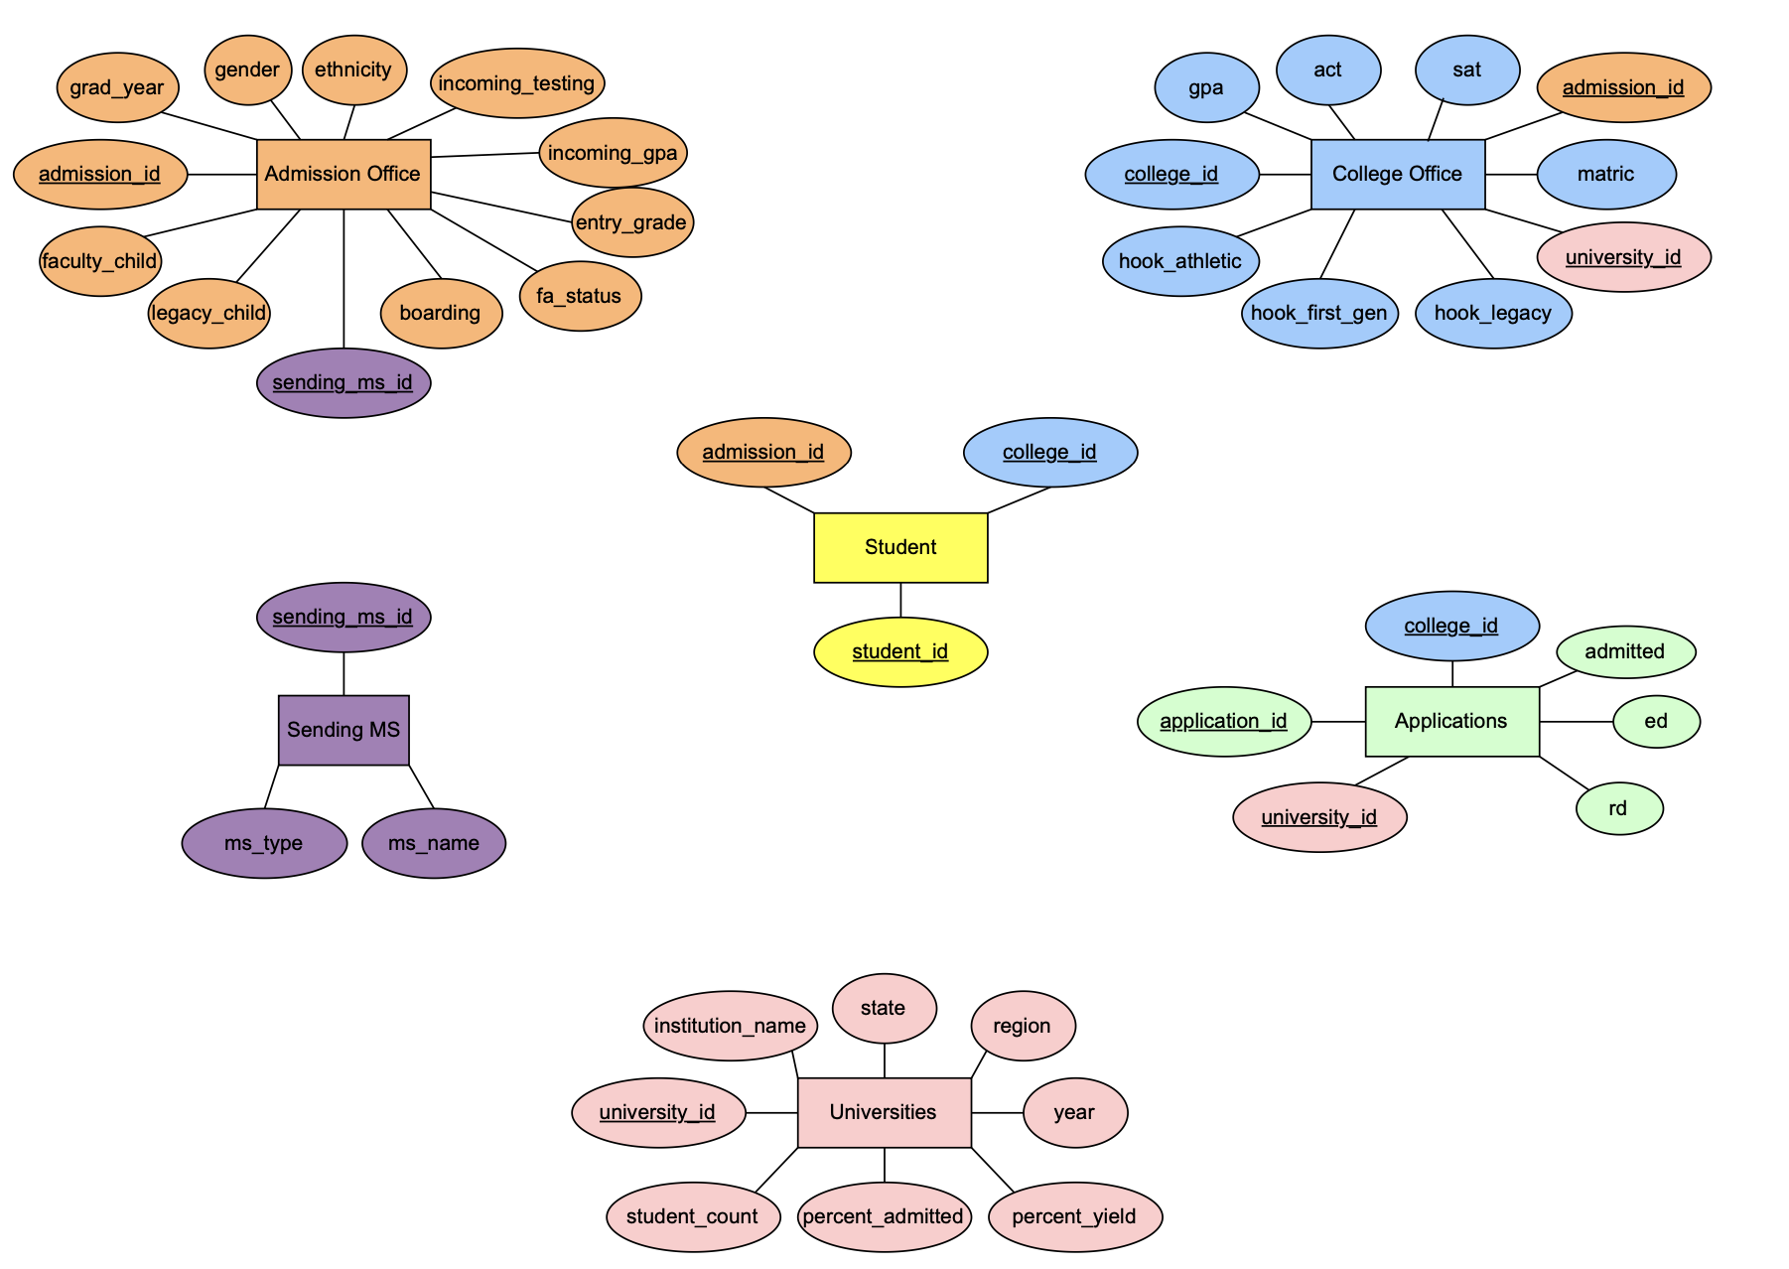
STUDENT provides links to all tables
Notes:
STUDENT is the key link between the siloed offices (and in literature is often referred to as a Junction Table)

Slide 7
Challenges During Integration

Slide 8
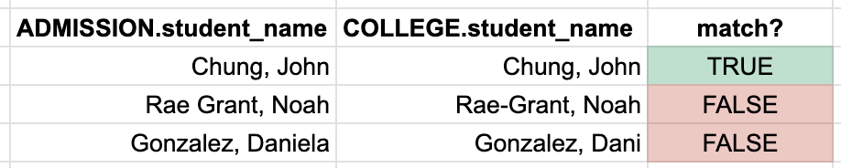
Challenge: Student_name as Primary Key
Challenge
Manually entered student names lack consistency
Use of nicknames vs. legal names.
Alumni who change their maiden name.
Typos or formatting differences
Best practice
Primary keys should:
Be unique integers
Avoid ambiguous identifiers like names
Notes:
The initial phase of this project involved attempting to merge the real databases from Academy X’s Admission and College Offices.
A significant issue encountered during this process was that both offices used student_name as a primary key in their spreadsheets. Neither office followed consistent criteria for formatting names, resulting in mismatches between ADMISSION.student_name and COLLEGE.student_name.

Slide 9
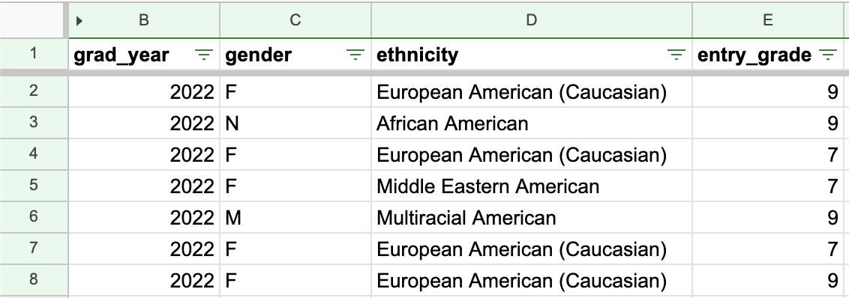
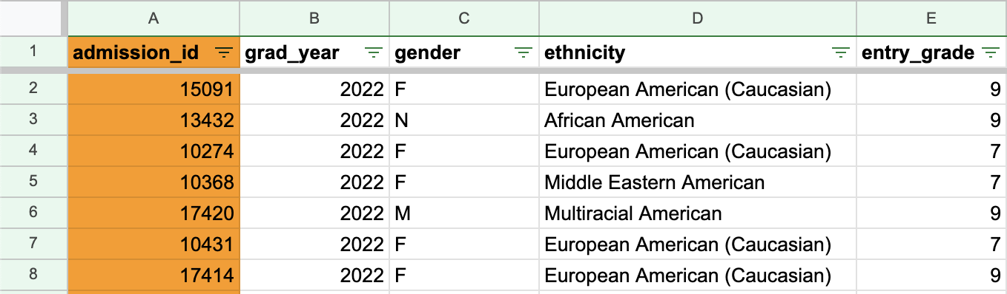
Challenge: Student_name as Primary Key
Solution
Generate integer primary keys for sileod tables
Notes:
Solutions:
Assign integer primary key to COLLEGE OFFICE data ADMISSION OFFICE data
Validate data: try to match by first_name + last_name
Use additional identifying data to validate remaining unmatched ids (ex: email, grad year, demographics)
Store student_id, college_id, admission_id in Junction Table to link the siloed tables together
In real-life, both offices retained additional data fields that could be used to validate and reconcile unmatched records, such as:
Email address
Graduation year
Demographics (gender, race/ethnicity, financial aid status)
While we ultimately generated our data for privacy reasons, this issue underscores an important best practice in database design: the use of integer-based primary keys to uniquely identify records. To address similar real-life challenges, leveraging secondary fields for data validation (ie, email and graduation year) is a practical workaround to improve data integrity and ensure successful integration across systems.

Slide 10
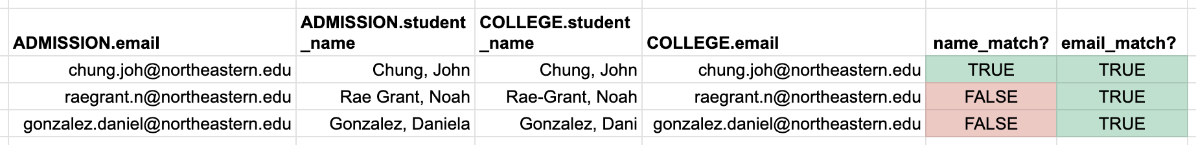
Challenge: Student_name as Primary Key
Solution
Generate integer primary keys for sileod tables
Validate student_ids using secondary data fields
Notes:
Solutions:
Assign integer primary key to COLLEGE OFFICE data ADMISSION OFFICE data
Validate data: try to match by first_name + last_name
Use additional identifying data to validate remaining unmatched ids (ex: email, grad year, demographics)
Store student_id, college_id, admission_id in Junction Table to link the siloed tables together
In real-life, both offices retained additional data fields that could be used to validate and reconcile unmatched records, such as:
Email address
Graduation year
Demographics (gender, race/ethnicity, financial aid status)
While we ultimately generated our data for privacy reasons, this issue underscores an important best practice in database design: the use of integer-based primary keys to uniquely identify records. To address similar real-life challenges, leveraging secondary fields for data validation (ie, email and graduation year) is a practical workaround to improve data integrity and ensure successful integration across systems.

Slide 11
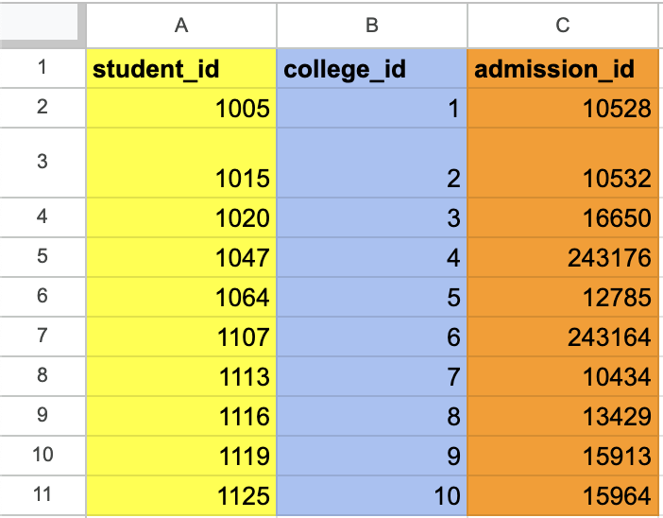
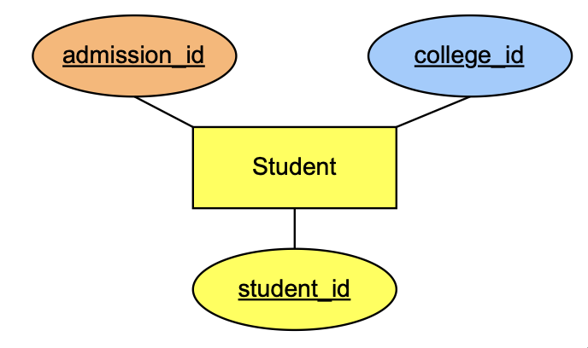
Challenge: Student_name as Primary Key
Solution
Generate integer primary keys for sileod tables
Validate student_ids using secondary data fields
Link siloed tables together in a Junction Table
Notes:
Solutions:
Assign integer primary key to COLLEGE OFFICE data ADMISSION OFFICE data
Validate data: try to match by first_name + last_name
Use additional identifying data to validate remaining unmatched ids (ex: email, grad year, demographics)
Store student_id, college_id, admission_id in Junction Table to link the siloed tables together
In real-life, both offices retained additional data fields that could be used to validate and reconcile unmatched records, such as:
Email address
Graduation year
Demographics (gender, race/ethnicity, financial aid status)
While we ultimately generated our data for privacy reasons, this issue underscores an important best practice in database design: the use of integer-based primary keys to uniquely identify records. To address similar real-life challenges, leveraging secondary fields for data validation (ie, email and graduation year) is a practical workaround to improve data integrity and ensure successful integration across systems.

Slide 12

Challenge: Data Privacy & Confidentiality
Challenge
Using real student data without permission would violate Academy X’s data privacy rules.
Best practice
Every institution should have a data governance rules around the access of their data.
Define clear guidelines for data access, sharing, and retention
Restrict data access using role-based permissions
Encrypt sensitive data and use secure authentication methods
Notes:
- One of the biggest challenges we ran into with this project is that using real student data from Academy X would violate their data privacy rules.
- As such, we were not able to directly use real student data due to very understandable privacy concerns when using the data of minors. Given the small size of the school, that information is not easy to truly deidentify in a way that remains useful for analysis. To address this, our group decided to model generated data, but using the actual data fields that are kept at Academy X.
Additionally, Academy X is currently in the process of revising its data governance rules, so as a bonus deliverable of this final project, our group has offered some best practice recommendations for the school (shown on the right)
—
John's Notes: Another challenge was that using real student data for this final project would violate Academy X’s privacy rules. To address this, our group decided to model generated data, but using the actual data fields that are kept at Academy X.
Additionally, Academy X is currently in the process of revising its data governance rules, so as a bonus deliverable of this final project, our group has offered some best practice recommendations for the school (shown on the right)
—----------------------------------------------
Independent schools should prioritize:
Institutional Policies: Define clear guidelines for data access, sharing, and retention.
Access Control: Restrict data access using role-based permissions.
Data Security: Encrypt sensitive data and use secure authentication methods.
Protecting student data is an essential responsibility for independent schools. Families entrust institutions to handle sensitive data ethically and securely. Independent schools must define their own governance policies, including role-based access controls and encryption, to safeguard student records. Establishing clear guidelines for data sharing, retention, and regular audits can further reduce risks and ensure ethical handling of information.

Slide 13
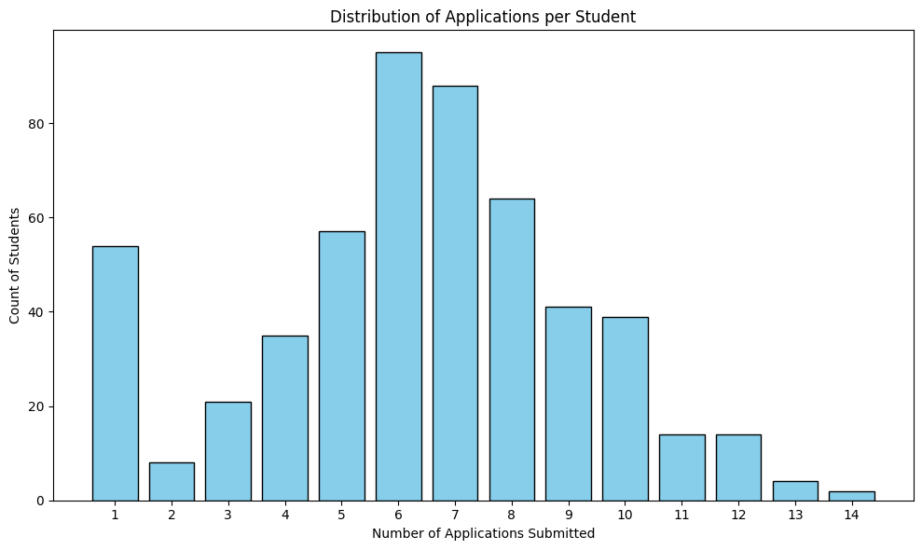
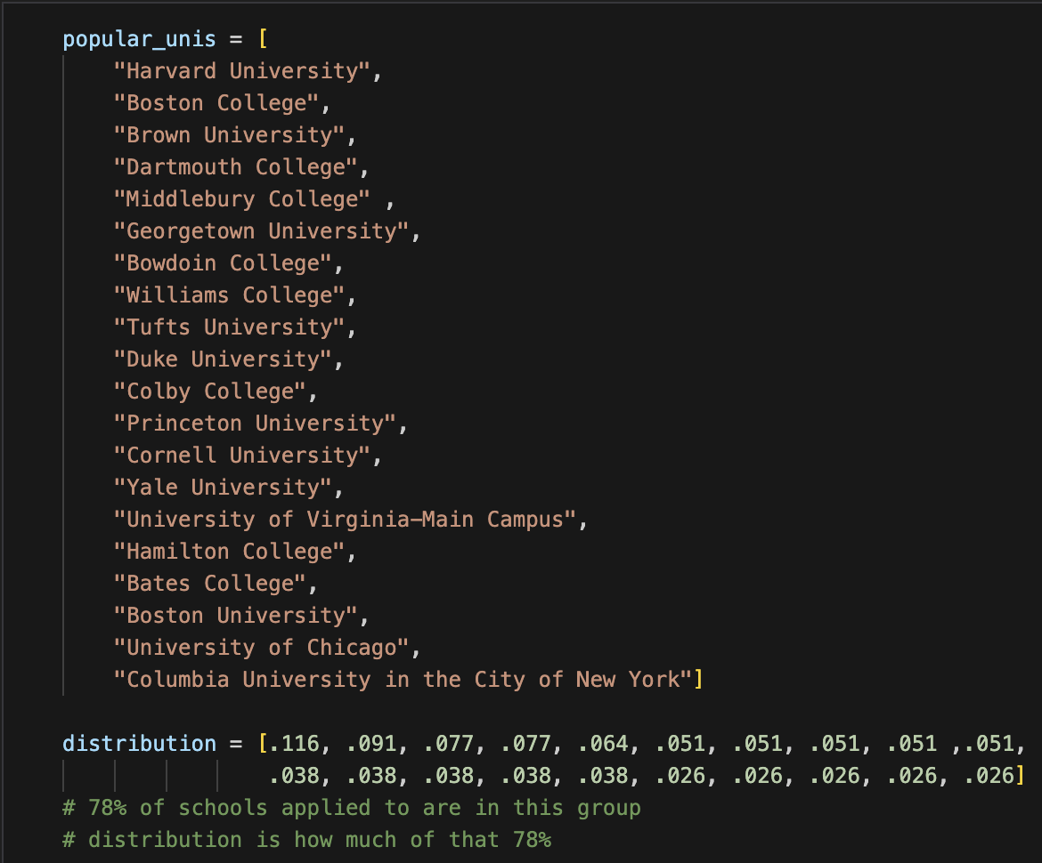
Challenge: Data Privacy & Confidentiality
Solution
For our DS5110 Final Project, we utilized real data fields from Academy X, but generated student data based on assumptions and expected distributions
Notes:
- Because we had the real data fields and their types, as well as expected distributions, we were able to model somewhat realistic student data. Distributions included: 78% of applications from Academy X are for 20 specific colleges, 20% of the student body are recruited athletes who only apply to one school, and 10% of students are on full financial aid, as well as the region distribution of college applications from Academy X.
- From this, we were able to simulate data that mimicked the real data, thanks to Numpy's ability to set the distribution weights when selecting from a given array. Whether a student was "admitted" after applying was also randomized, depending on if a random number from 0 to 100 was less than or equal to the university's percent admitted statistic. This in itself required its own data cleaning process in order to remove duplicate values and ensure that every "student" in the database was admitted to at least one university (which is the expectation at Academy X).
- One snag we ran into is that, because 22% of the applications were randomly selected using only regional distributions from a very large list of universities, some of the colleges and universities "applied" to by our data are not ones that students from Academy X would ever apply to (such as a very obscure nursing program in Erie, PA Erie 2 Chautauqua Cattaraugus BOCES-Practical Nursing Program). If we did this process again, we would likely create a more narrow universities database that included only ones students would realistically apply to.
John's Notes:
To comply with Academy X’s data governance and privacy policies, real student data was not utilized. Instead, data was generated based on predetermined distribution levels, leveraging the expertise and insights of a group member with connections to Academy X.
For example, the APPLICATIONS table was designed according to the following specifications:
Around 20% of the student body should be recruited athletes who only apply to one university.
The remaining students submit applications to between 1 and 15 unique universities.
The number of applications submitted per student and universities applied to were structured to mimic realistic distributions. Code was developed to generate data satisfying these criteria, incorporating random seeding with preferential bias towards the most popular universities, which represent 78% of applications students submit from Academy X.

Slide 14
Relational Database

Slide 15
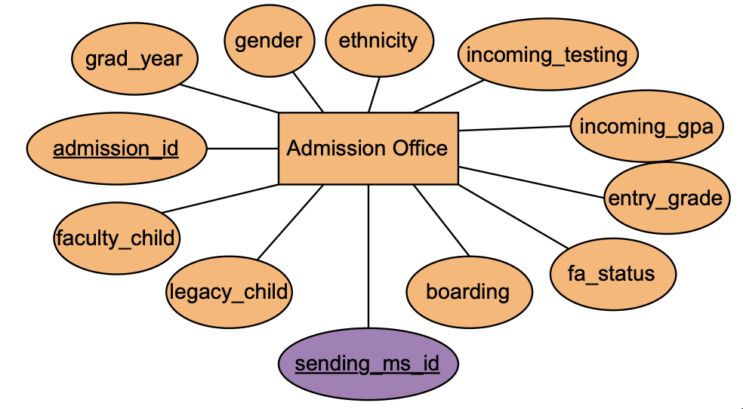
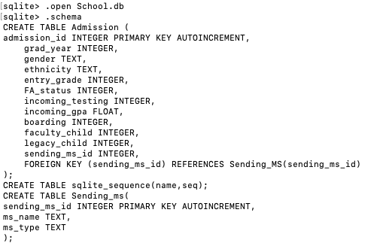
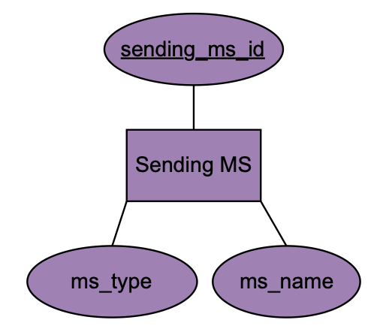
Create School.db using SQLite

Slide 16
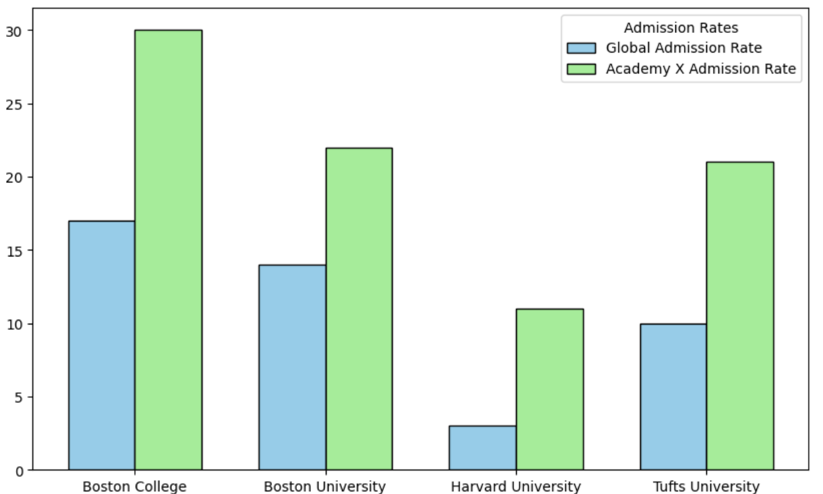
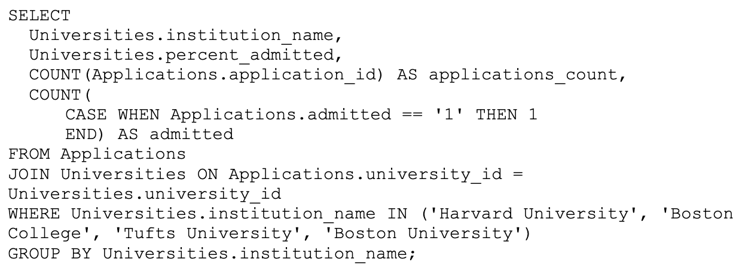
Example 1: Comparing Admission Rates
Compare Academy X's admission rate into popular Boston Universities and compare this to each University's global admit rate.
Notes:
Each Universities admission rate (# of students admitted / # of student applying) is publicly available from IPEDS (Integrated Postsecondary Education Data System).
Adding this public data into our UNIVERSITIES table allows us to compare Academy X’s admission rate vs. the universities overall admission rate.
For example, the SQL query and data visualization show that Academy X has a notably higher admissions rate into these universities when compared against the public admission rate.
This analysis highlights the potential advantage Academy X students have in gaining admission to these universities, possibly due to strong academic preparation, targeted application strategies, or existing relationships between Academy X and these institutions.

Slide 17
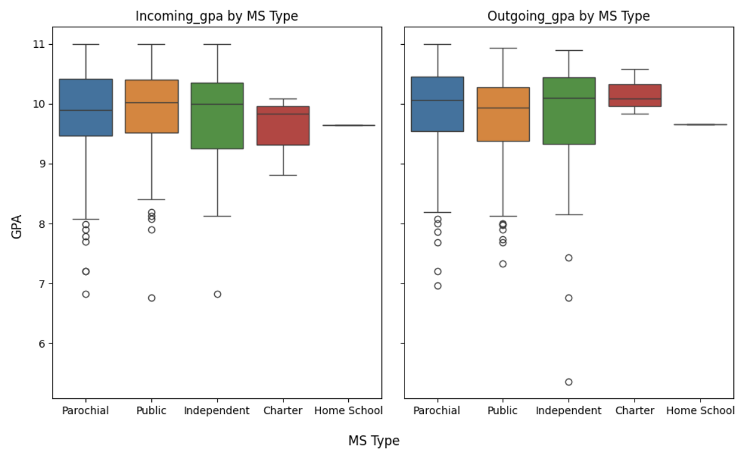
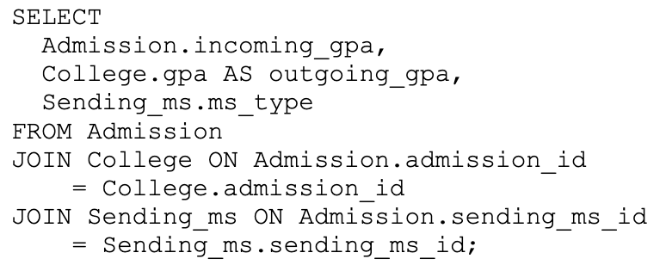
Example 2: Comparing Incoming and Outgoing GPA
Compare incoming and outgoing GPAs, grouped by MS type.
Notes:
Example 2 highlights the type of analysis that can be done once the two siloed databases have been integrated.
Grouping incoming gpa (stored in Admission office) and outgoing gpa (stored in College Counseling) by Middle School sending type allows Academy X to explore the impact and correlation of sending MS on a students GPA.
Since the data is housed in an integrated relational database, additional filters can easily be applied to control for other factors (example: financial aid status) to allow for deeper insights into the extent that Sending MS type impacts outgoing GPA.

Slide 18
Conclusions

Slide 19
Concluding Ideas
While the results of our project are not "real", the process and queries are, and real-world results should follow similar patterns.
A relational database is useful for more complex queries than siloed databases can find alone.
Simulating data such that it mirrors real data as effectively as possible is an interesting challenge.
Notes:
- While the results we found are not "real", the database merging process and queries are, and real-world results should follow similar patterns. Many of the queries are based on John's actual work doing data analysis for Academy X, and would not have been possible without merging these two databases.
- The student junction table could be used for many other uses at Academy X, such as linking a student's course schedule, grades, and extracurricular activities, but we kept it pared down to only what this project needed.
- Ultimately, our project was about creating a data pipeline, from raw data to a relational database to queries and analysis.

Slide 20
Unused Slides

Slide 21
Incoming student data in ADMISSION
Sending Middle Schools
Admission Office

Slide 22
Outgoing student data in COLLEGE
College Counseling
Universities

Slide 23

Data is siloed…
Admission Office
College Counseling

Slide 24
…but can be merged with a relational DB!
Admission Office
Students
College Counseling

